Slide 1
Jakarta Business Clustering
Dionisius Darryl Hermansyah
June 2020

Slide 2
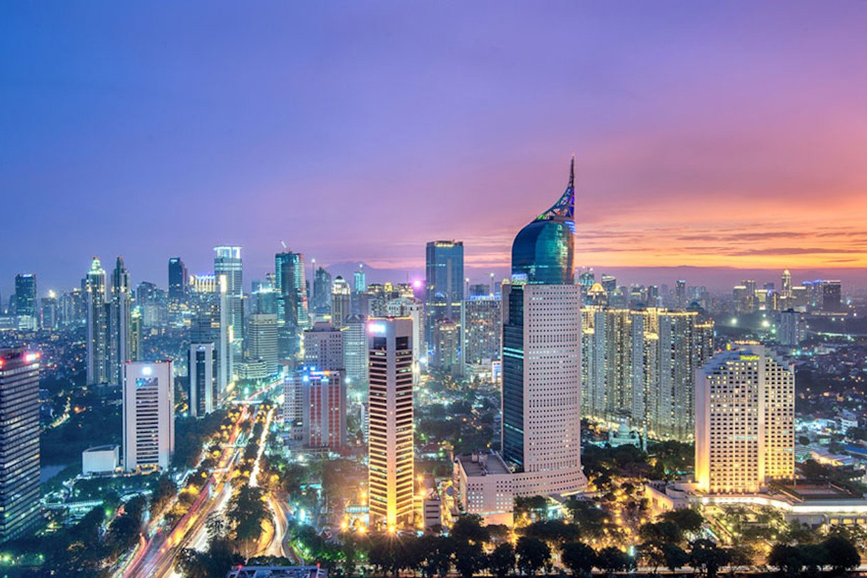
Goals
“To explore and cluster the neighborhoods in Jakarta, Indonesia and also to determine the best location for various business placement”

Slide 3
Target Audience
Potential constructor who wants to start their own business and need a recommendation for setting up their office in Jakarta
Existing company who wants to renew their place in a different area of neighborhoods in Jakarta
Anyone who is interested in neighborhood clustering using Python as a data science tools

Slide 4
Data
Wikipedia that provides list of Jakarta neighborhoods (https://en.wikipedia.org/wiki/List_of_districts_of_Jakarta)
FourSquare API that provides surrounding venues of a given coordinates.

Slide 5
Methodology
Web scraping
Getting the coordinates
Data visualization
Venues exploration using FourSquare API
One-hot encoding
K-Means Clustering

Slide 6
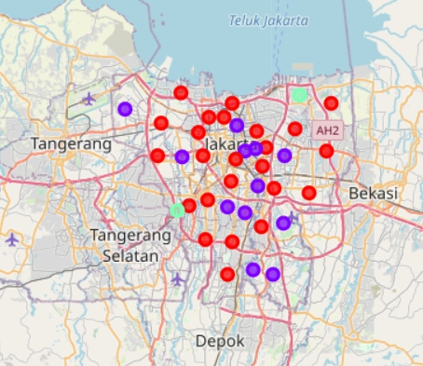
Result & Discussion
According to the dataframe, the most frequent venue that we may look at for each neighborhood is food industries such as restaurant, food court, café, etc. It is recommended for business owner that want to start their businesses to get away from food since there are abundant venues already.

Slide 7
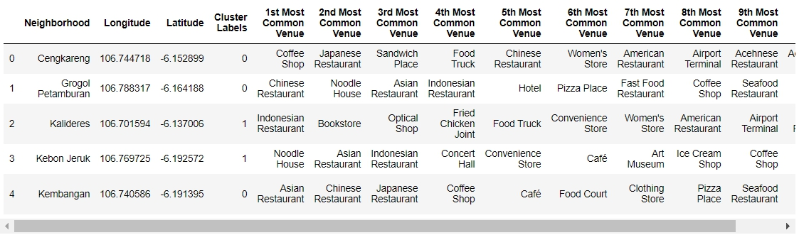
Result & Discussion
All in all, cluster 0 would be the best spot for all kind of businesses to be placed in, that includes 24 neighborhoods
On the other hand, cluster 1 and 2 are worse than cluster 0, that includes 14 neighborhoods

Slide 8
Conclusion
In conclusion, the best clusters for businesses placement in Jakarta are neighborhoods in cluster 0 that contains mostly food, health, hospitality, and entertainment industries.

